Slide 1

ALGORITHM
VISUALIZER

Slide 2
Team Members:
1. SIDDHARTH SINGH(181500710)
2. SURYANSHU GUPTA(181500740)
3. KAVYA SINGH(181500319)
4. SPARSH GUPTA(181500723)
5. HARSHIT JAISWAL(181500255)

Slide 3
What is Algorithm Visualizer
Algorithm-visualizer is a web app written in React.It consists of sorting methods like Bubble, insertion, selection and quicksort where the user can visualize different sorting algorithms . Algorithms and data structures form one cornerstone of an undergraduate computer science education. A technique for improving in this critical area is to include algorithm and data structure visualizations.

Slide 4
Reason for selecting the topic
Analysis and design of algorithms is a great challenge for computer science student’s .We selected this project because we were fascinated by sorting algorithms, and we wanted to visualize them in action.This Project is a fully automatic visualization system. Design principles and technical structure of the visualization system as well as its practical implications and educational benefits are presented and discussed.

Slide 5
Hardware & Software to be used:
Software: VS Code , Github ,Git Bash
Technologies: React , CSS, JavaScript, HTML
Hardware:
· RAM:- 4.00GB
· Processor:- Intel(R)Core(TM) i3-4005U CPU @ 1.70GHz

Slide 6

What is REACT?
React (also known as React.js or ReactJS) is an open-source, front end, JavaScript library for building user interfaces or UI components. React is a JavaScript library created by Facebook. React can be used as a base in the development of single-page or mobile applications.

Slide 7
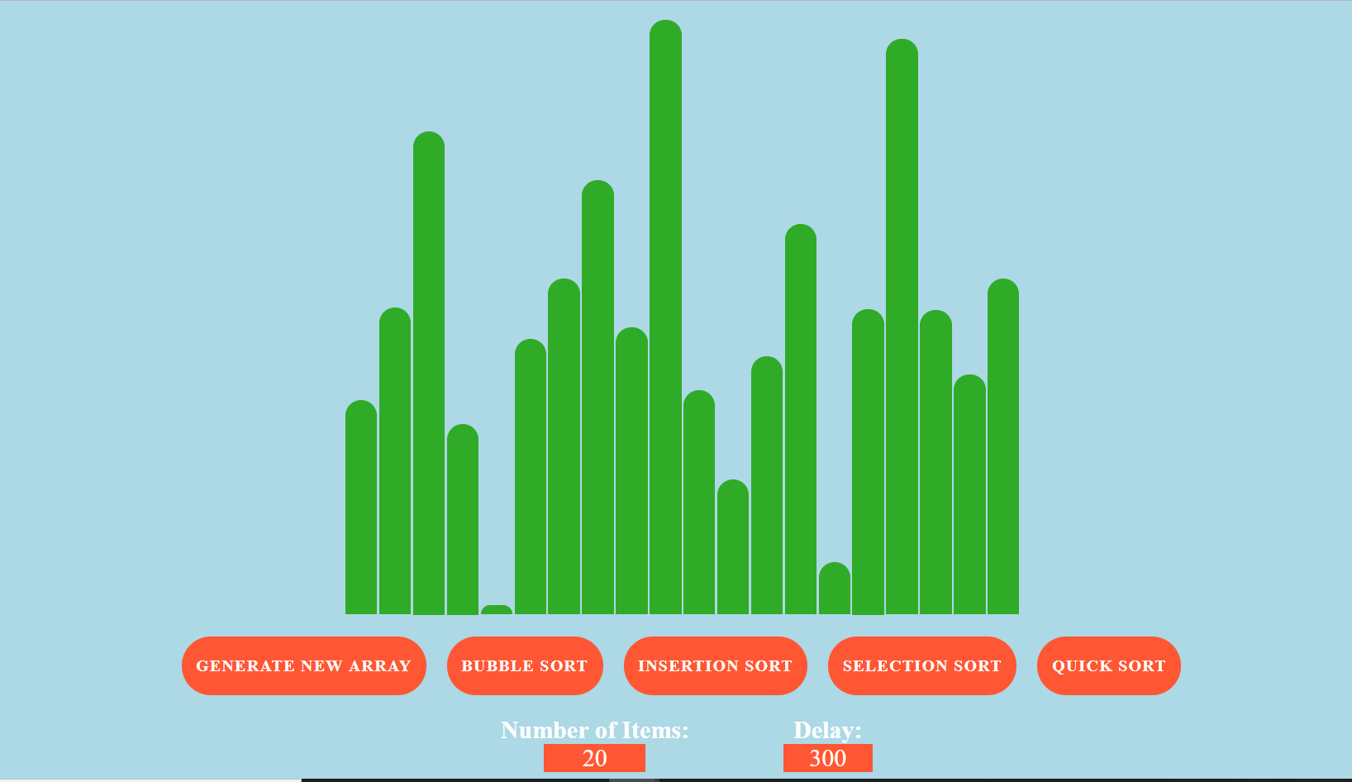

Slide 8
Working:
In this working project the user can set the size of the unsorted array (i.e 2 to 1000) as well as the time of delay in microseconds. We have used different colours to make the user visualize different algorithms.Initially the unsorted array is of green colour and the comparison is depicted by yellow colour resulting the higher order element is given purple colour.

Slide 9
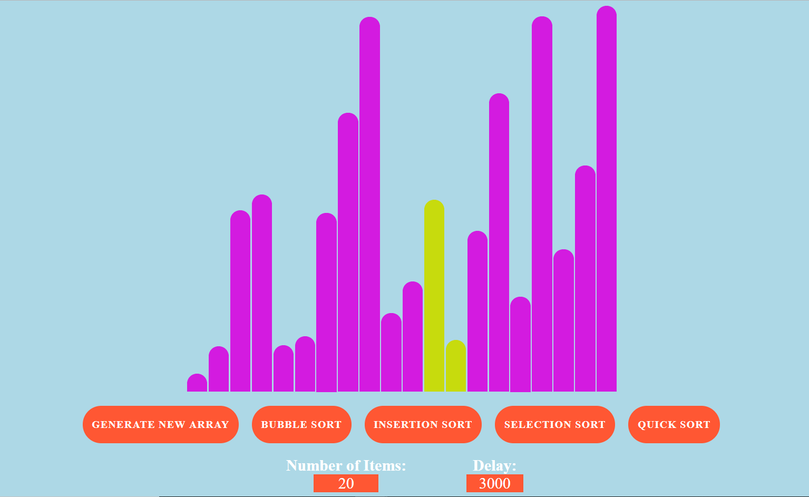

Slide 10
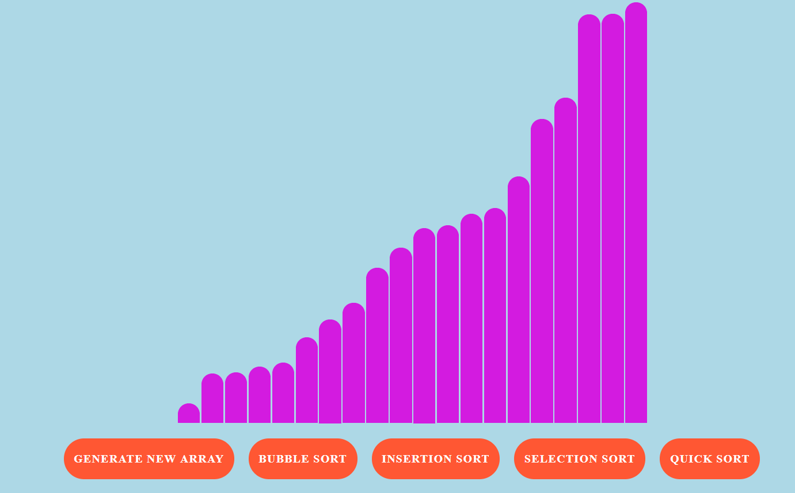

Slide 11
Bubble Sort Algorithm
Bubble Sort is the simplest sorting algorithm that works by repeatedly swapping the adjacent elements if they are in wrong order
Worst and Average Case Time Complexity: O(n*n). Worst case occurs when array is reverse sorted.
Best Case Time Complexity: O(n). Best case occurs when array is already sorted.

Slide 12
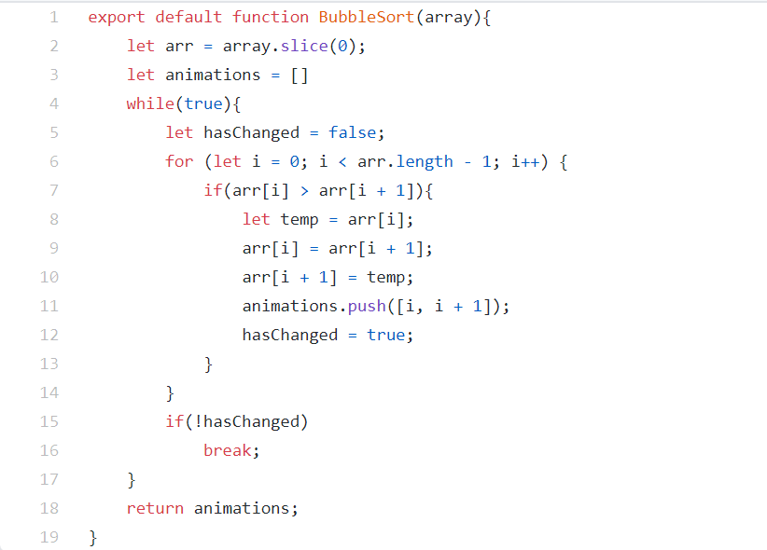
BUBBLE SORT CODE

Slide 13
Insertion Sort Algorithm
Insertion sort is a simple sorting algorithm that works similar to the way you sort playing cards in your hands. The array is virtually split into a sorted and an unsorted part. Values from the unsorted part are picked and placed at the correct position in the sorted part.
Worst and Average Case Time Complexity: O(n*n). Worst case occurs when array is reverse sorted.
Best Case Time Complexity: O(n). Best case occurs when array is already sorted.

Slide 14
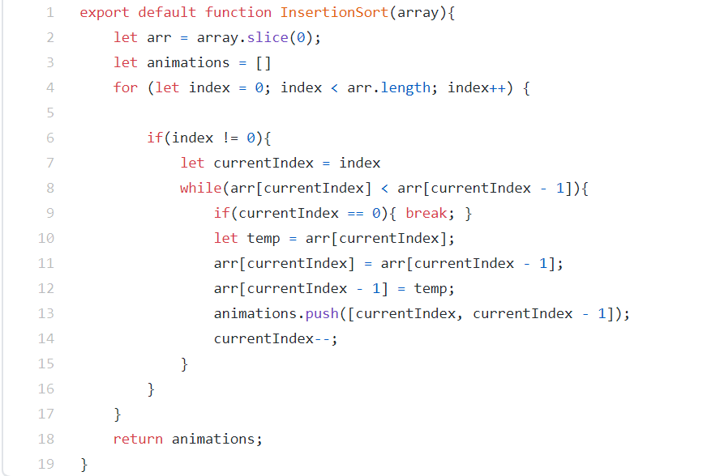
INSERTION SORT CODE

Slide 15
Selection Sort Algorithm
The selection sort algorithm sorts an array by repeatedly finding the minimum element (considering ascending order) from unsorted part and putting it at the beginning
Time Complexity:O(n^2) for all cases.

Slide 16
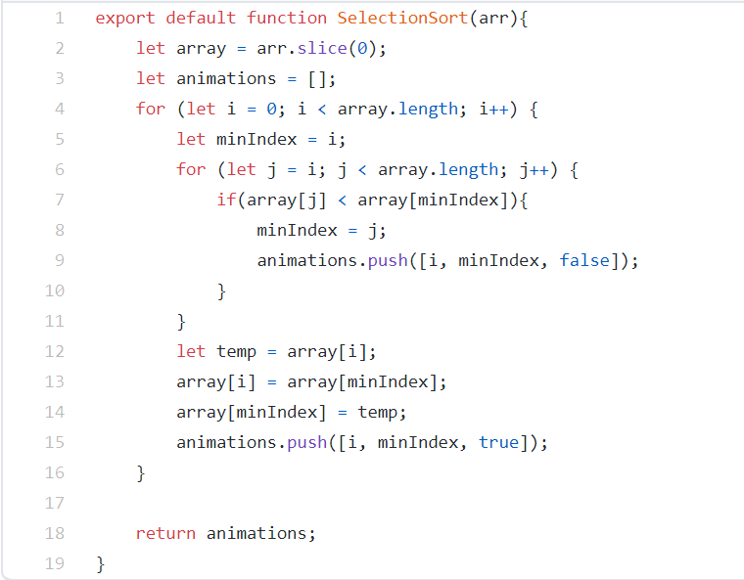
SELECTION SORT
CODE

Slide 17
Quick Sort Algorithm
QuickSort is a Divide and Conquer algorithm. It picks an element as pivot and partitions the given array around the picked pivot
Best Case and Average case Time Complexity: O(nlog n).
Worst Case Time Complexity : O(n*n).

Slide 18
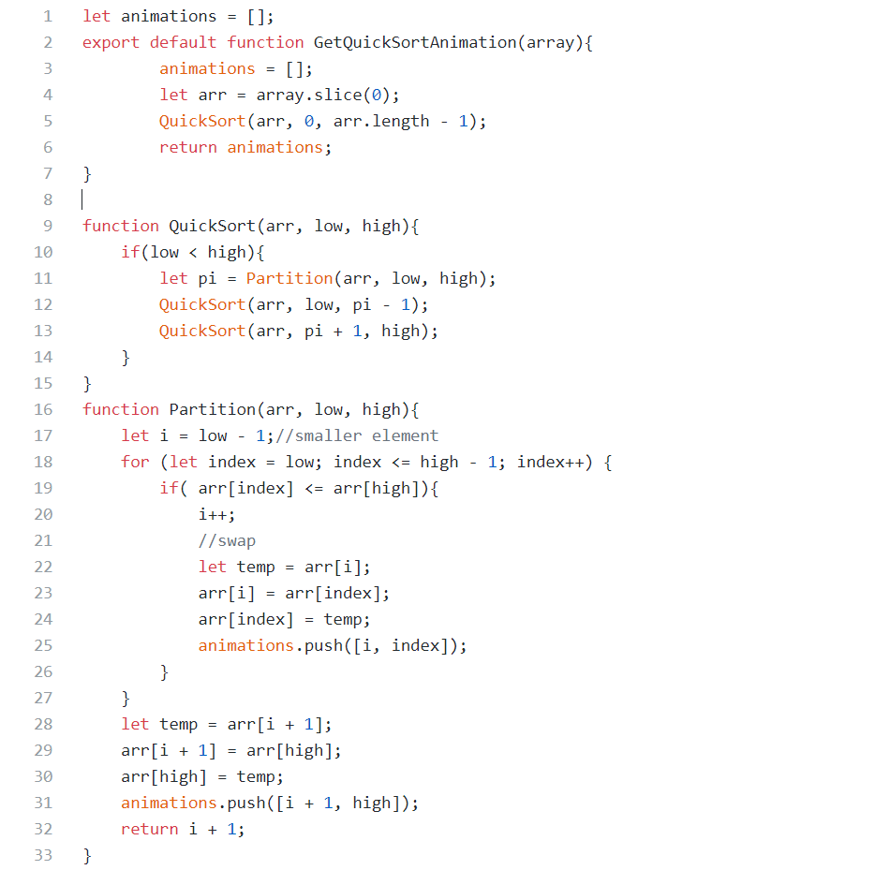
QUICK SORT CODE

Slide 19
GITHUB DEPLOYMENT
Since we have deployed our react app on github so we first we have to add a homepage on package.json file and then install gh-pages by using few commands. We have to deploy the site by using npm run deploy then optionally we can configure the domain with github pages

Slide 20
Commands used to deploy it on github
To publish it at https://myusername.github.io/my-app, run: npm install --save gh-pages
Alternatively you may use yarn: yarn add gh-pages
Add the following scripts in your package.json:
"scripts": {
+ "predeploy": "npm run build",
+ "deploy": "gh-pages -d build",
"start": "react-scripts start",
"build": "react-scripts build",

Slide 21
What is Git Bash
Git Bash is an application for Microsoft Windows environments which provides an emulation layer for a Git command line experience. Bash is an acronym for Bourne Again Shell. A shell is a terminal application used to interface with an operating system through written commands.
To deploy our project we have also used the git bash software
Notes:
To deploy it we have also used the git bash software

Slide 22
THANK
YOU

